Slide 1

Static Website Hosting on Azure Storage
Group 10 :
Rithika Thirumala 21891A0559
Thatikonda Akash 21891A0558
A Sudha Reddy 21891A0501
Srikanth Sreemanth 21891A0549

Slide 2
What is Azure Storage Account?
Flexible Storage
Diverse Options
Provides a scalable, secure, and cost-effective way to store data of various types.
Includes Blob storage for unstructured data, Queue storage for messaging, and Table storage for structured data.

Slide 3
Create a Storage Account
1
Open the Azure Portal and navigate to Storage Accounts.
2
Click Create to start the creation process.
3
Fill in the required details:
Resource Group: Choose an existing resource group or create a new one for better organization.
Storage Account Name: Enter a unique name that meets Azure's naming requirements.

Slide 4
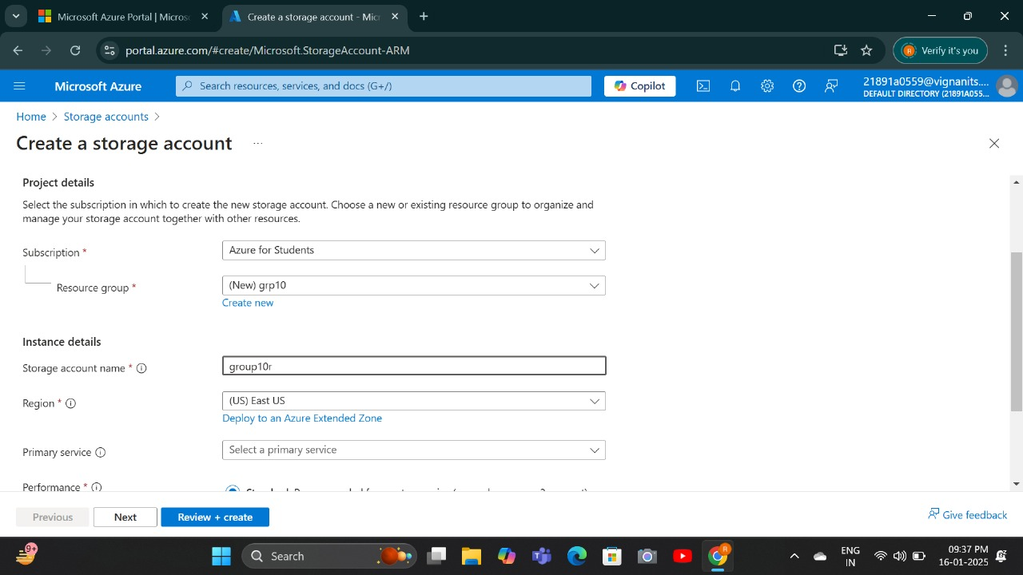
create a storage account with storage name and resource group name

Slide 5
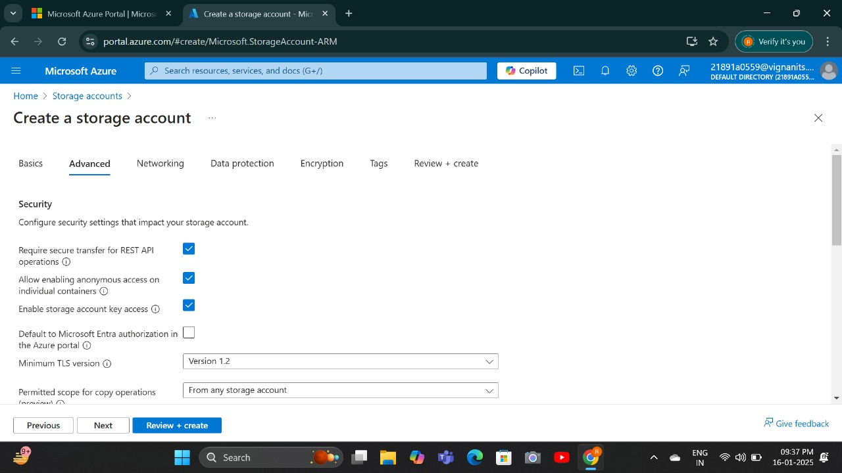
select the required options to create storage account

Slide 6
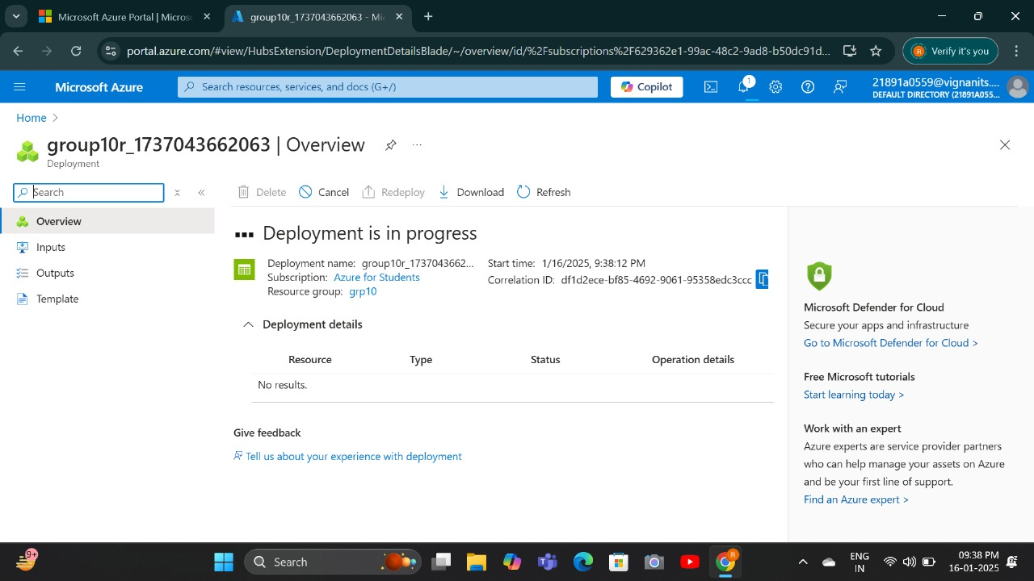
Storage account has been Deployed

Slide 7
Create a Web Page
HTML
CSS
JavaScript
Create an index.html file with the content of your website.
Style the website using a CSS file (e.g., style.css).
Add JavaScript code (e.g., script.js) for interactive elements.

Slide 8



Enable Static Website Feature
Open the created Storage Account in the Azure Portal.
2. Scroll down to the Data Management section in the left-hand panel and select Static Website.
3. Click Enable to turn on the static website hosting.
4. In the Index document name field, type index.html (or the main file name of your website).
5. Save the settings.
This file will be displayed when users visit the root of your website.

Slide 9
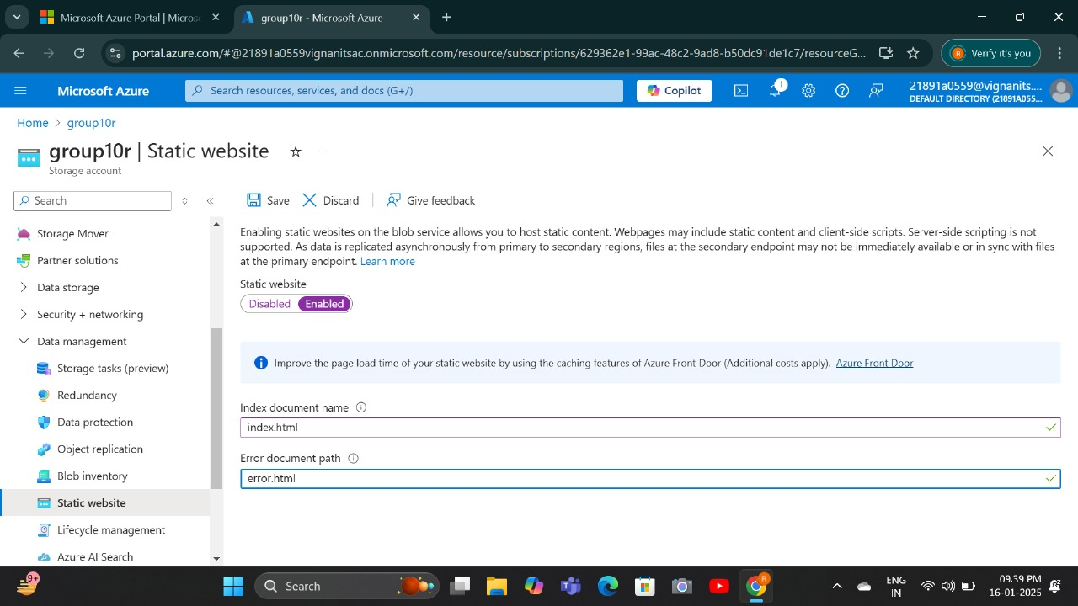
Now in Storage account get into static website

Slide 10
Access the $web Container
Storage Explorer
In the Storage Account, go to the Containers section under the Data Storage menu.
1
2
$web Container
You will see a container named $web. Click on it to open.

Slide 11
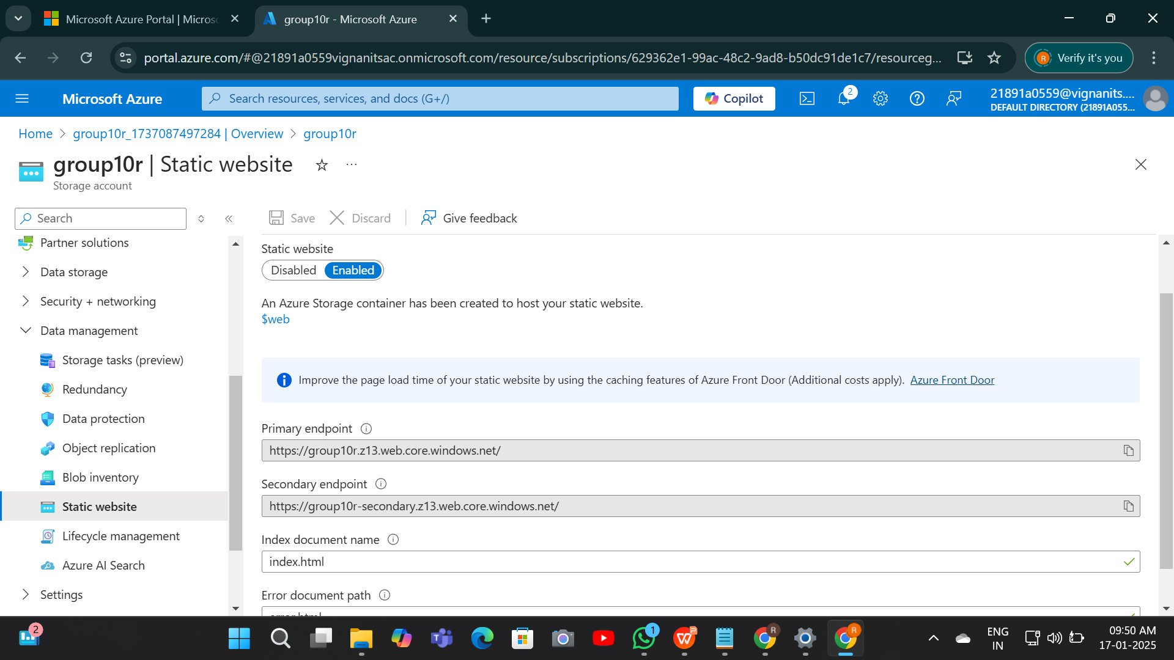
Access the $web Container

Slide 12



Upload Website Files
Upload Files
Click on the Upload button within the $web container.
Verify Upload
Use one of the following methods to upload files:
Drag and Drop: Drag your index.html (and other files, if any) into the upload area. Browse: Click the Browse button to locate and select files manually.
Click Upload to confirm and complete the process.

Slide 13
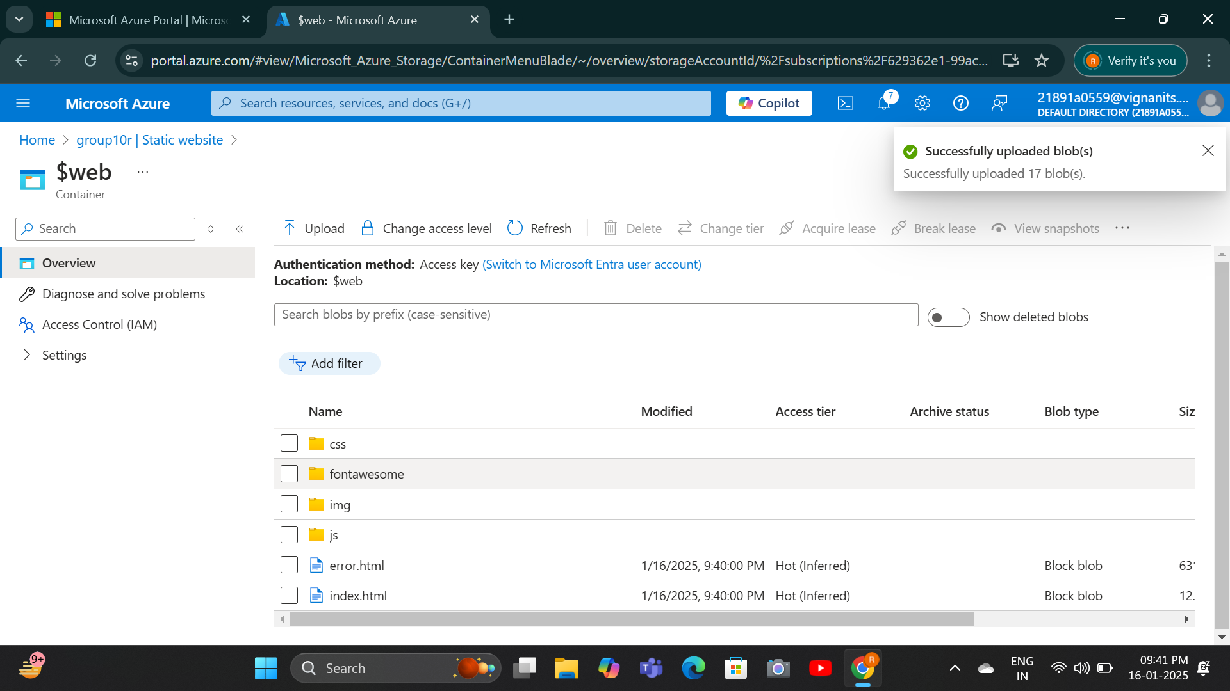
Upload all the files related to the Website

Slide 14



Test the Static Website
1
Get Website URL
Open in Browser
2
Paste the URL into your web browser.
Verify Functionality
3
Check if all elements are working correctly.

Slide 15
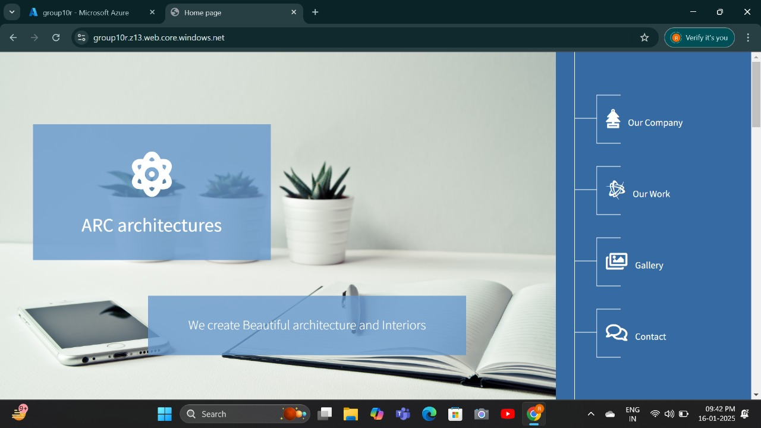
This is the Website that we hosted using storage account

Slide 16
Benefits of Using Azure Storage for Static Websites
1
Cost-Effectiveness
Hosting static websites on Azure Storage is significantly cheaper compared to using traditional web hosting solutions.
2
Scalability
The service can handle traffic spikes without additional configuration.
3
High Availability
Azure ensures data redundancy and availability, making your website resilient to failures.
4
Simplicity
No need to manage web servers or complex configurations.
Global Reach
5
Azure's globally distributed data centers ensure low-latency access for users worldwide.

Slide 17
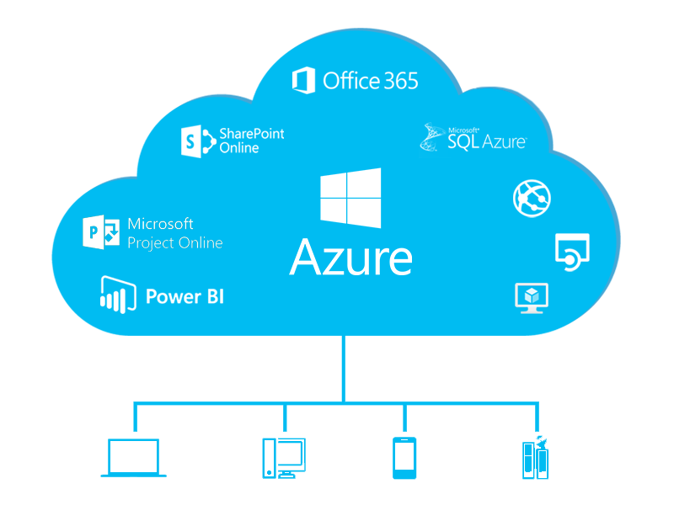
Conclusion :
By following the steps above, you can successfully host a static website on Azure Storage Account. This solution is ideal for lightweight, static content with minimal setup and maintenance.
It offers Cost-Effectiveness , High Availability , Scalability , Simplicity and Global Reach.

Slide 18
THANK YOU !

